Slide 1
Introduction to Database
Lecture 6

Slide 2
Normalization
A process used for data modelling to organize data for efficiently addition and updating.
It is done
To prevent anomalies (insert, delete, update)
To make database efficient and accurate data.
To reduce space storage

Slide 3
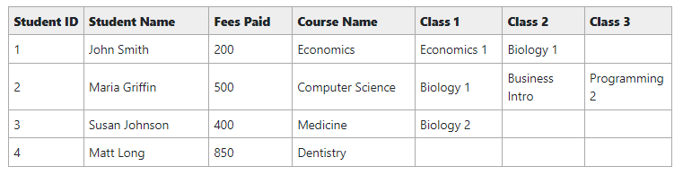
Data Anomalies
An issue in data when data in not normalized.

Slide 4
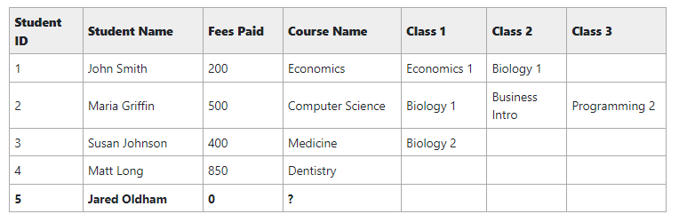
Insert Anomaly
An issue when we try to insert a record without knowing all the data.

Slide 5
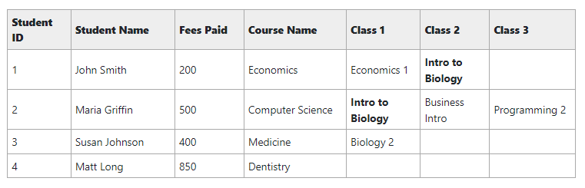
Update Anomaly
An issue when we try to update a record.

Slide 6
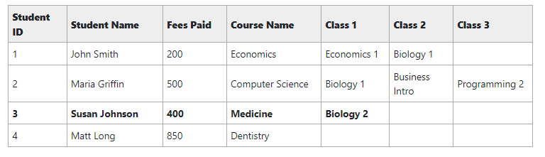
Delete Anomaly
An issue when we try to delete a record.

Slide 7
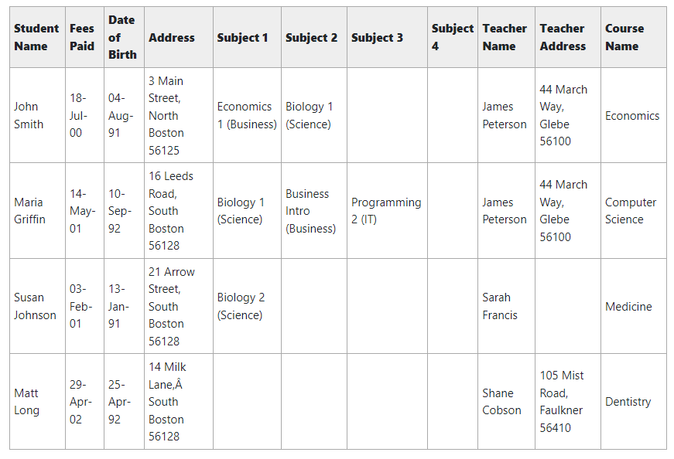

Slide 8
First Normal Form (1NF)
A table is in 1NF if:
There are only single valued attributes.
Attribute domain does not change.
There is a unique name for every attribute.
Following questions are asked for it:
Does the combination of all columns make a unique row for every single time
What field can be used to uniquely identify the row? (If there no such column then make a new one)

Slide 9
In above table the first question hold true but there is no primary so add student id as a primary key which uniquely identifies all other attributes.
The new student table contains
Student(Student ID, Student Name, Fees Paid, Date of Birth, Address, Subject 1, Subject 2, Subject 3, Subject 4, Teacher Name, Teacher Address, Course Name)

Slide 10
Second Normal Form (2NF)
A table is in 2NF if:
Fulfill the requirements of 1NF.
Each non-key attribute must be functionally dependent on primary key (No partial functional dependency)

Slide 11
Student(Student ID, Student Name, Fees Paid, Date of Birth, Address, ` Subject 1, Subject 2, Subject 3, Subject 4, Teacher Name, Teacher Address, Course Name)
Lets look at each column:
Student ID -> Student Name, Fees Paid, Date of Birth, Address (Valid FDs)
Student ID -> Subject 1, Subject 2, Subject 3, Subject 4, Teacher Name, Teacher Address, Course Name (Invalid FDs)

Slide 12
Subject (Subject ID, Subject Name)
Teacher (Teacher ID, Teacher Name, Teacher Address)
Course (Course ID, Course Name)
Student (Student ID, Student Name, Fees Paid, Date of Birth, Address)

Slide 13
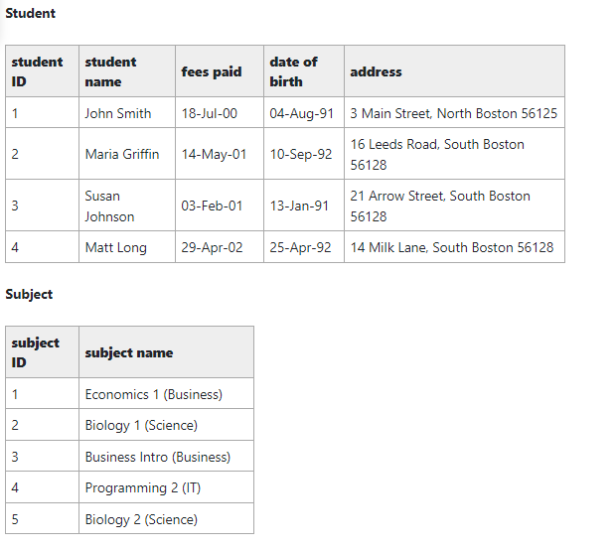
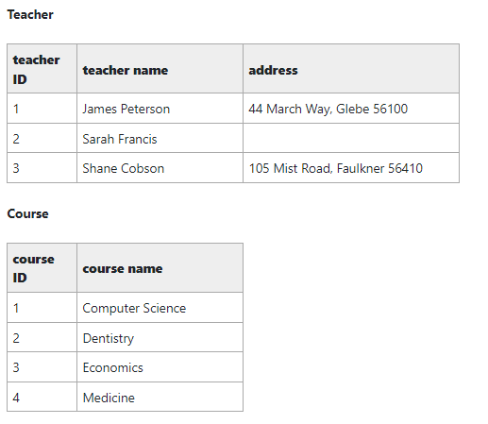

Slide 14
Add Foreign Key Relationship
Now we have to link tables through primary, foreign keys relationship.
The current view of database is:
Subject (Subject ID, Subject Name)
Teacher (Teacher ID, Teacher Name, Teacher Address)
Course (Course ID, Course Name)
Student (Student ID, Student Name, Fees Paid, Date of Birth, Address)

Slide 15
Student and Course
A course have many students, so Course ID will go in Student table
The current view of database is:
Subject (Subject ID, Subject Name)
Teacher (Teacher ID, Teacher Name, Teacher Address)
Course (Course ID, Course Name)
Student (Student ID, Course ID (FK), Student Name, Fees Paid, Date of Birth, Address)

Slide 16
Teacher and Course
A teacher can teach many courses, so Teacher ID will go in Course table
The current view of database is:
Subject (Subject ID, Subject Name)
Teacher (Teacher ID, Teacher Name, Teacher Address)
Course (Course ID, Teacher ID (FK), Course Name)
Student (Student ID, Course ID (FK), Student Name, Fees Paid, Date of Birth, Address)

Slide 17
Student and Subject
A student can take many subject, and similarly many students can be enrolled in a subject. Hence it is a many to many relationship, so we create a new table named Subject Enrollment.
The current view of database is:
Subject (Subject ID, Subject Name)
Subject Enrollment (Student ID (FK), Subject ID (FK))
Teacher (Teacher ID, Teacher Name, Teacher Address)
Course (Course ID, Teacher ID (FK), Course Name)
Student (Student ID, Course ID (FK), Student Name, Fees Paid, Date of Birth, Address)

Slide 18
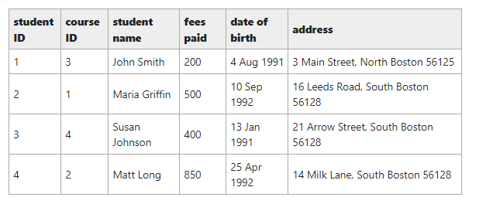
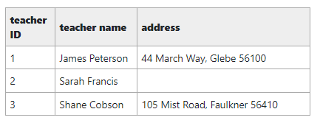
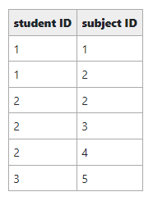
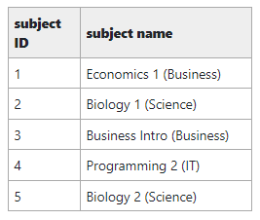
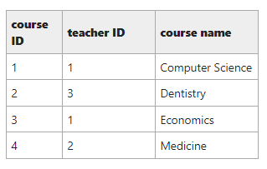

Slide 19
Third Normal Form (3NF)
A table is in 3NF if:
Fulfill the requirements of 2NF.
Each non-key attribute must be functionally dependent only on primary key (No transitive functional dependency)
There is no such dependency exist in the current example, however the address is a composite attribute (state, city, zip code).
So transitive FD exist in Student table as:
Student ID -> Zip Code
Zip Code -> City

Slide 20
Fourth Normal Form (4NF)
Also called BCNF. A table is in 4NF if:
Fulfill the requirements of 3NF.
There are no non-trivial multivalued dependencies other than candidate keys.
In our current view of database there are many questions:
Both student and teacher have street address and zip code
What of student/teacher have multiple addresses
What if both have same addresses
And many more. So it creates multivalued dependencies.
Hence moving the address to a separate table.

Slide 21
Subject (Subject ID, Subject Name)
Subject Enrollment (Student ID (FK), Subject ID (FK))
Teacher (Teacher ID, Teacher Name)
Course (Course ID, Teacher ID (FK), Course Name)
Student (Student ID, Course ID (FK), Student Name, Fees Paid, Date of Birth)
Address Code (Zip Code, City, State)
Address (Address ID, Street Address, Zip Code (FK))
Student Address (Address ID (FK), Student ID (FK))
Teacher Address (Address ID (FK), Teacher ID (FK))

